Slide 1
Speaker recognition and Language recognition report
Speaker：张楚瑜
Member：李晓波、胡越洋、王明涛
instructor：徐新

Slide 2
Contents
01
Project purpose
CONTENTS
02
Methods
03
Experiment
04
Conclusion

Slide 3
Project purpose
/01
What is language recognition?
What is speaker recognition?

Slide 4
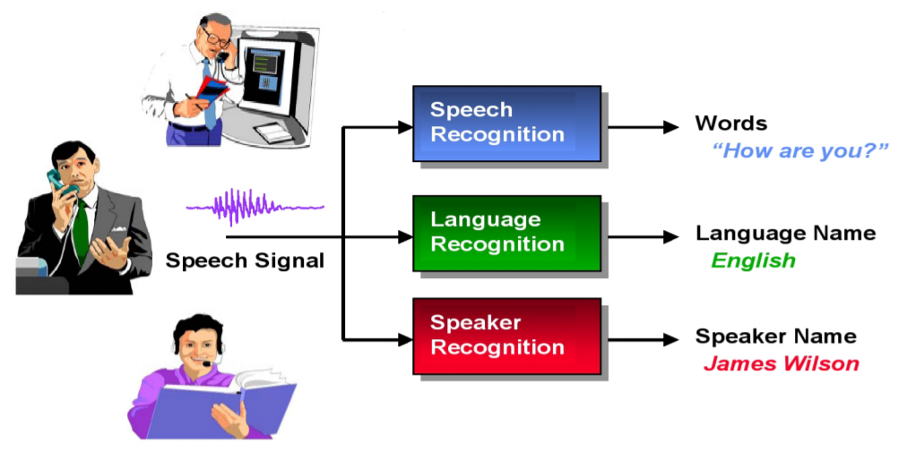
What is language recognition?

Slide 5
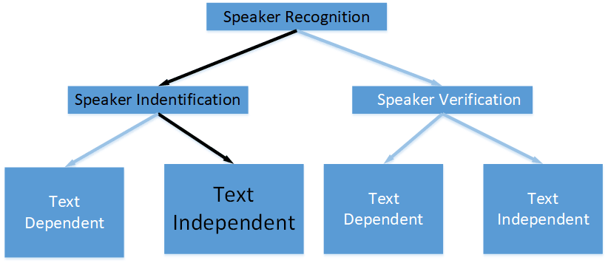
What is speaker recognition?

Slide 6
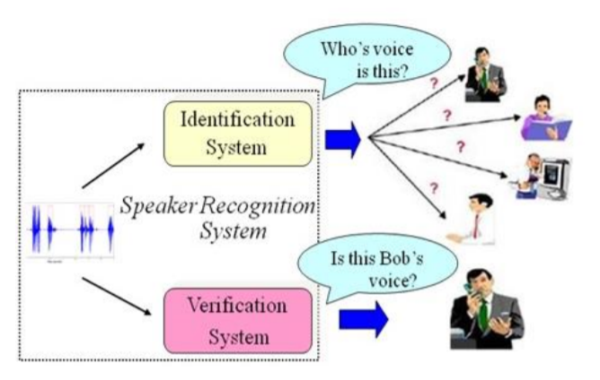
What is speaker recognition?
Speaker recognition is the identification of a person from characteristics of voices. It is used to answer the question "Who is speaking?"
Speaker verification is a 1:1 match where one speaker's voice is matched to a particular template.

Slide 7
Method
/02
Model basic framework
GMM-UBM
d-vector

Slide 8
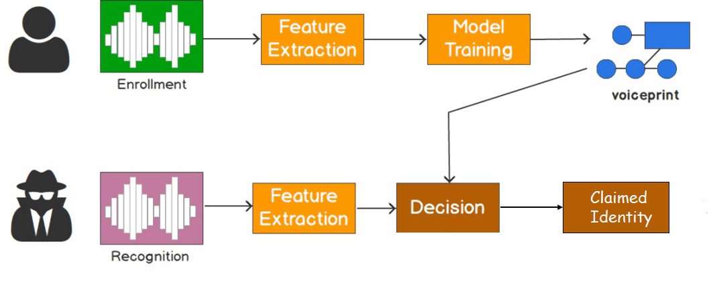
Model basic framework
Feature：mfcc，plp，lpc，i-vector，d-vector.
Model：DTW，GMM-UBM,cosine.

Slide 9
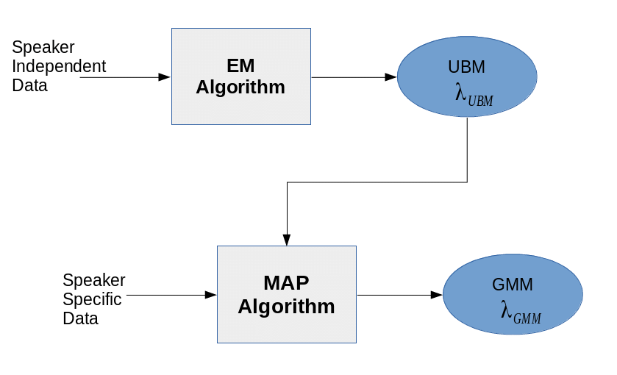
GMM-UBM

Slide 10
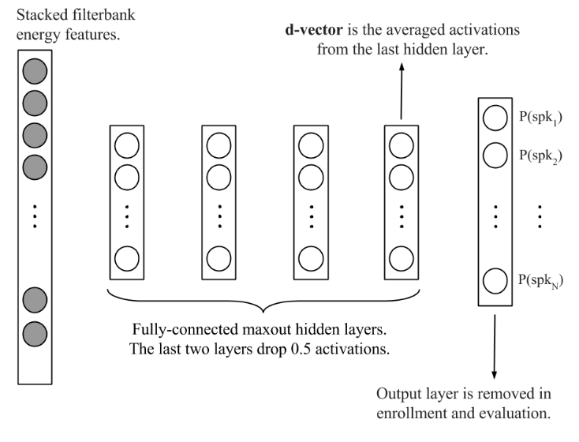
d-vector
frame-level :Judging speaker in frame.
utterance-level:Judging utterance in frame.
https://static.googleusercontent.com/media/research.google.com/
zhCN//pubs/archive/41939.pdf

Slide 11
d-vector
In the evaluation phase, we make decisions using the distance between the target d-vector and the test d-vector.

Slide 12
d-vector
First, we can reduce the DNN model size for runtime by pruning away the output layer, and this also enables us to use a large number of development speakers without increasing DNN size at runtime.
Second, we have observed better generalization to unseen speakers from the last hidden layer output

Slide 13
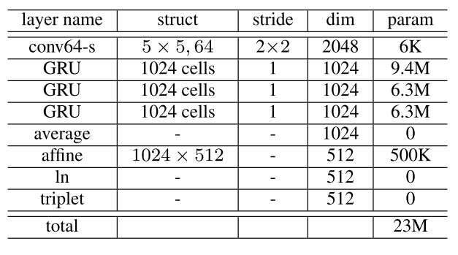
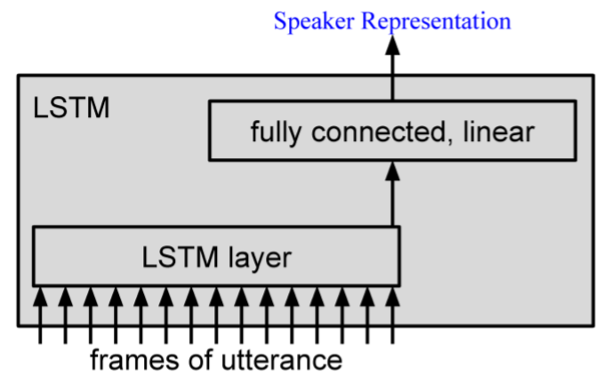
d-vector
https://arxiv.org/pdf/1705.02304.pdf
https://arxiv.org/pdf/1509.08062.pdf

Slide 14
Experiment
/03
Experiment prepare
Language recognition
Speaker recognition

Slide 15
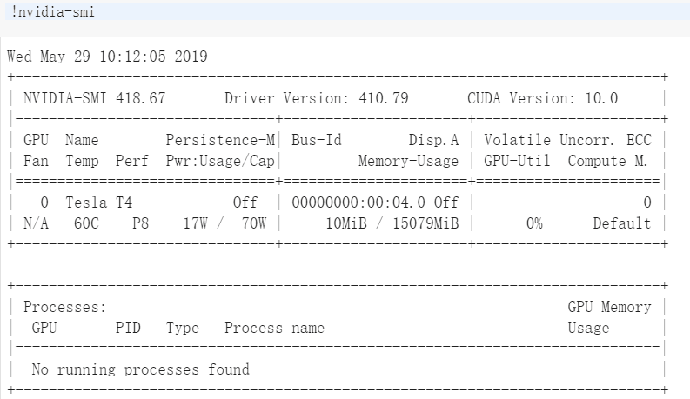
Experiment prepare
Google colab

Slide 16
Language recognition data
The dataset contains over 3453 utterances for 8 languages, which was downloaded from Kaggle. We select 70% of them as our train dataset in training phase while the rest as our test dataset. Then, we remove the silent speech and cut the speech into segments in seconds.

Slide 17
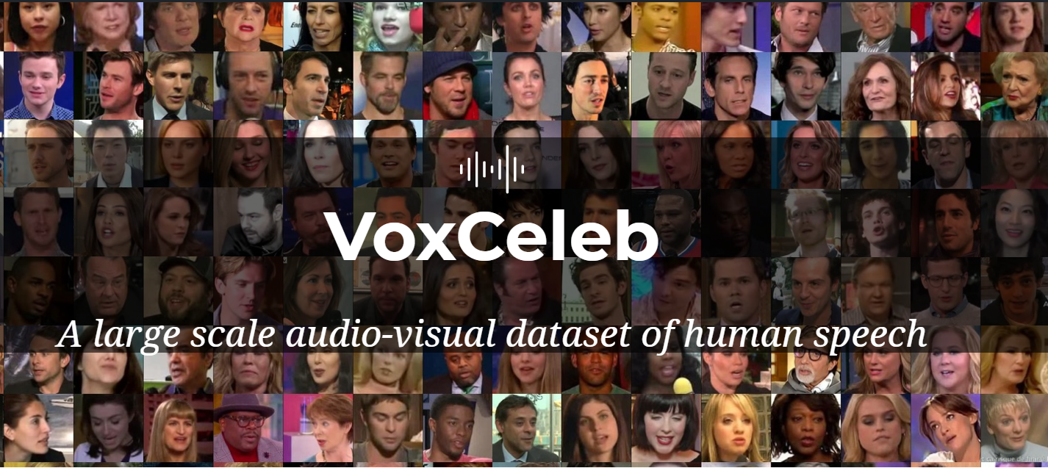
Speaker recognition data
VoxCeleb contains over 100,000 utterances for 1,251 celebrities, extracted from videos uploaded to YouTube. In training phase, we select 100 celebrities as our training dataset. In test phase, we select 40 celebrities.Then, we remove the silent speech and cut the speech into segments in seconds.
http://www.robots.ox.ac.uk/~vgg/data/voxceleb/

Slide 18
Language recognition

Slide 19
Language recognition

Slide 20
Speaker recognition
model | Train acc | Val acc | Train time per epoch(s) | Test acc | Test time(s)
NN | 0.532 | 0.467 | 1 | 0.368 | 12
GRU | 0.939 | 0.748 | 99 | 0.376 | 70
LSTM | 0.788 | 0.547 | 29 | 0.437 | 50
GRU model is overfitting, and LSTM model outerperforms others in test acc.
What's the effect of convolution layer?

Slide 21
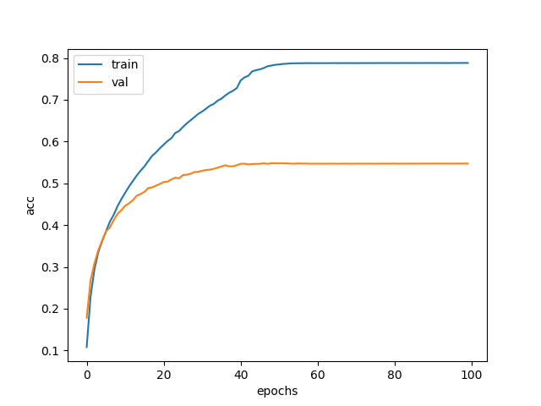
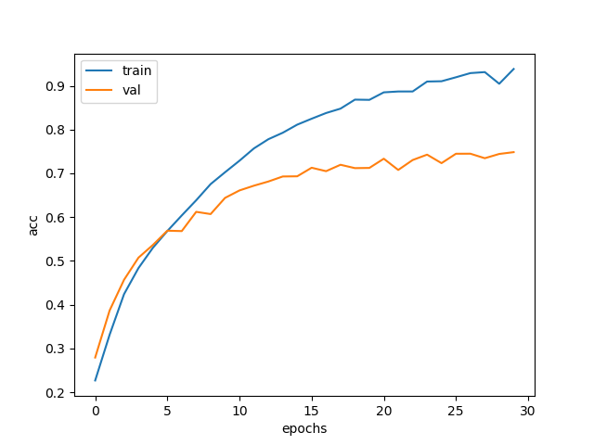
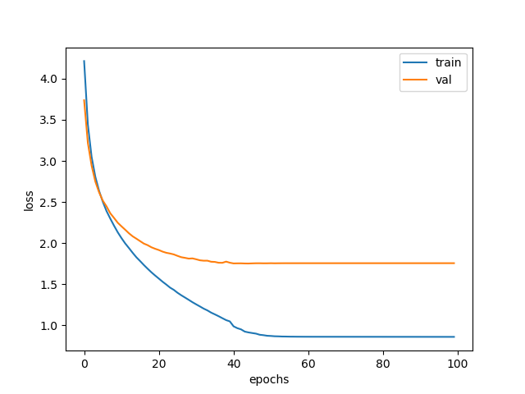
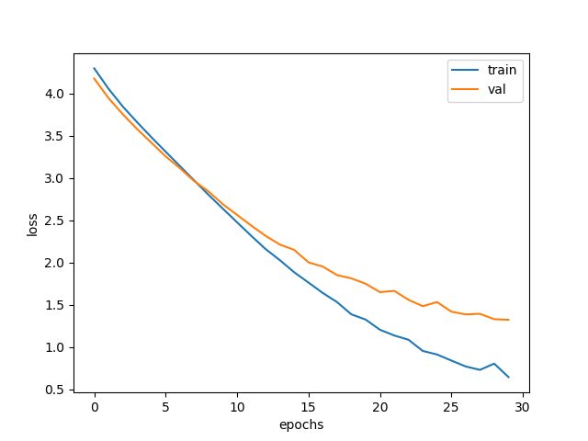
Speaker recognition
LSTM
GRU

Slide 22
Speaker recognition
We add a convolution layer to LSTM model and other requirement are still the same.

Slide 23
Speaker recognition
model | Train acc | Val acc | Train time per epoch(s) | Test acc | Test time(s)
NN | 0.532 | 0.467 | 1 | 0.368 | 12
GRU | 0.939 | 0.748 | 99 | 0.376 | 70
LSTM | 0.788 | 0.547 | 29 | 0.437 | 50
Conv+lstm | 0.920 | 0.641 | 14 | 0.522 | 31
Accuracy is 0.522 which is 0.085 higher than LSTM model.

Slide 24
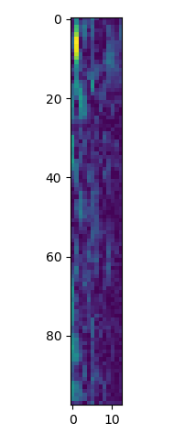
Speaker recognition
In our experiment, convolution extracts powerful feature from mfcc feature and in the meantime it leads to overfitting. GRU model’s input is 98*13*1 matrix, which is the same as image, but there is some difference. The pixels in image are equal, but the data in input matrix are not equal.Most of the energy is concentrated on the left which is the low frequency part of the voice. Convolution layer can extract pattern in frequency but lstm layer can not. We think that is the reason why convolution has effect on speech.

Slide 25
Conlusion
/04

Slide 26
Conlusion
In language recognition,we apply mfcc and plp feature and GMM-UBM model. we found mfcc and plp feature is still powerful and mfcc feature outperforms plp feature.
In speaker recognition, we explore d-vector based on dnn,gru,lstm model.And d-vector achieve 52.2% accuracy. what's more,we found convolution layer has effect on speech.

Slide 27
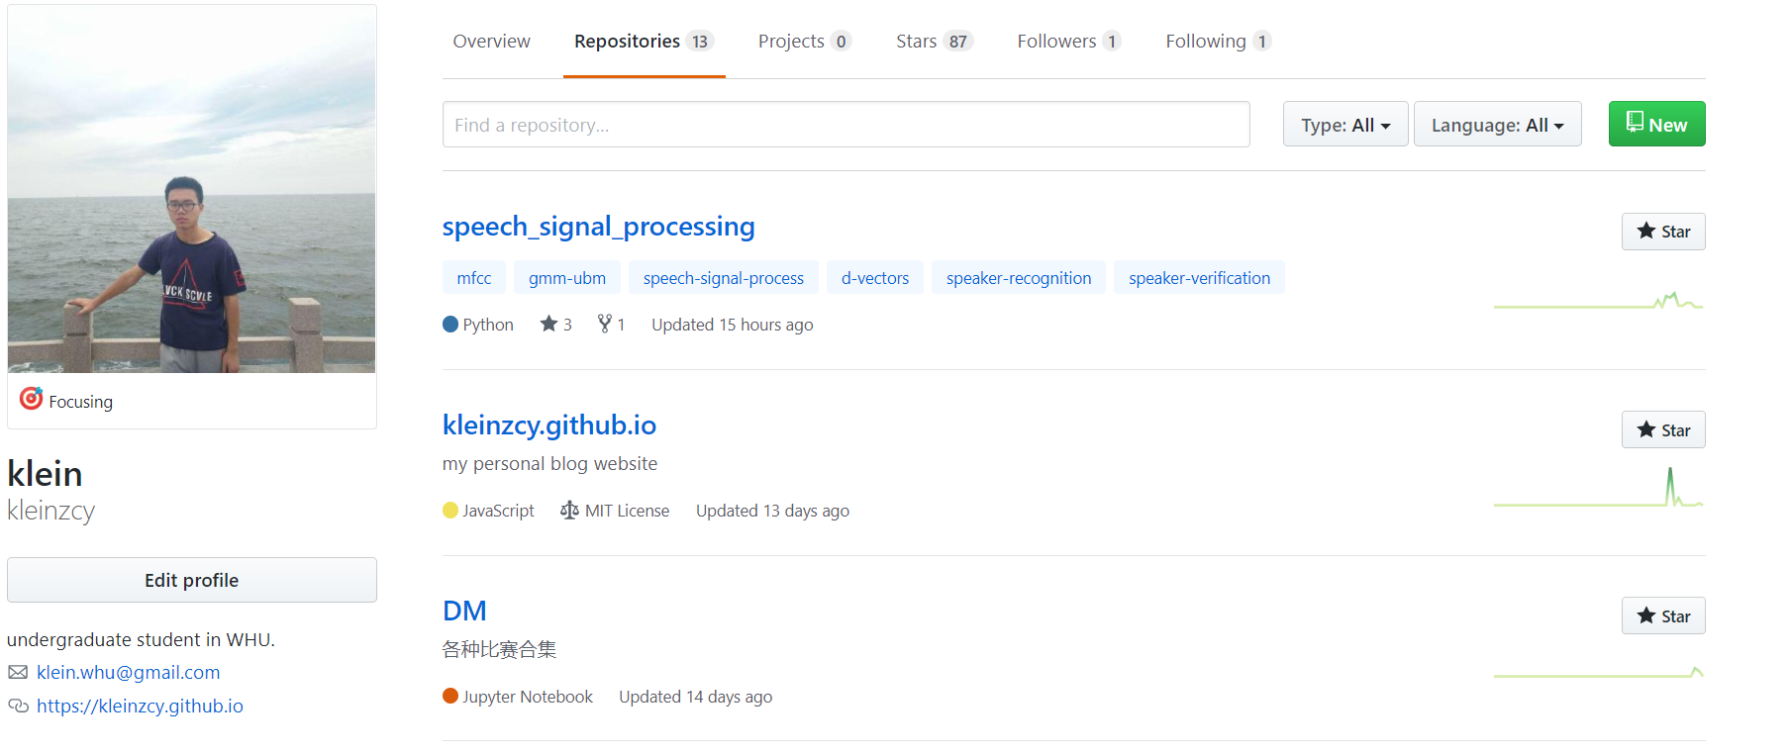

Slide 28
Thanks.

